Slide 1
How to set up and use an Integration Profile of type Users
Yoel Kortick
Senior Librarian
October 2024

Slide 2
Agenda
Introduction
Configuring an Integration Profile of type Users
The structure of the input file
The sample import file we will be using
Importing new users and updating existing users via synchronize
Exporting user records with blocks or fines via the Integration Profile
2

Slide 3
Introduction

Slide 4
Introduction
Users can be added to Alma via
  An Integration Profile of type "User" (this creates users of type "External" because they are created by and synchronized with an external system)
  An API (this can create users of type "External" or "Internal", and also update the user)
  Manually (this creates "Internal" users because they are handled internally)
In this presentation we will focus on the Integration Profile of type "User".

Slide 5
Introduction
The Integration Profile of type “Users” allows the institution to
Import users from an external system into Alma
Export users from Alma to an external system
See also:
  The Online Help for Integration Profile of type "User"
  How to use the Integration Profile of type users to create users with specific roles

Slide 6
Configuring an Integration Profile of type Users

Slide 7
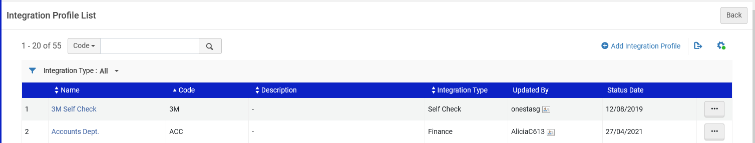
Configuring an Integration Profile of type Users
Navigate to the Integration Profile List page at “Configuration Menu > General > External Systems > Integration Profiles”
Select Add Integration Profile.

Slide 8
Configuring an Integration Profile of type Users
Enter a code and name for the profile you are defining.
From the Integration type drop-down list, select Users.
From the S/FTP connection type drop-down list, select the name of the FTP connection that you previously defined.
Indicate the type of system with which you are integrating (this has no functional effect; it is for Ex Libris’ informational purposes).
Optionally, enter a description of the integration you are configuring.
Select Next.

Slide 9
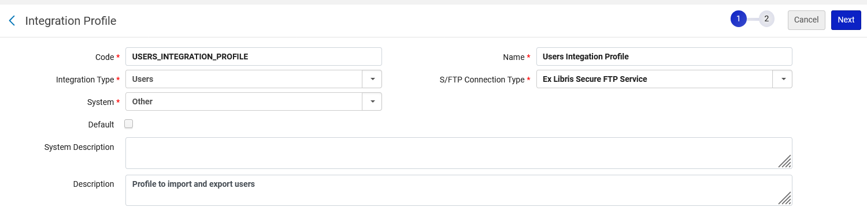
Configuring an Integration Profile of type Users
S/FTP Connection Type: The FTP server where the input file will be located and to where the export file will be exported
Integration Type: Define “Users”

Slide 10
Configuring an Integration Profile of type Users
We will now discuss four sections in the Integration Profile:
The “Import” section.
  The “Import” is used or the initial import of users. A record is not imported if a matching record is found. After running this for the initial import, use the Synchronize section (which we will discuss next).
The “ Synchronize” section
  The “Synchronize” is used for ongoing synchronization of existing Alma users and to add new users.
The “Export User By Conditions” section
  The “Export User By Conditions” is used to export users with specific blocks or fines and fees. Often an institution will need export the users with blocks or fines and fees to another internal office such as the registrar's office.
The “Export Users” section
  The “Export Users” is used to export all users or only certain users. For example, it is possible to export old, inactive, deleted, or recently updated/created users

Slide 11
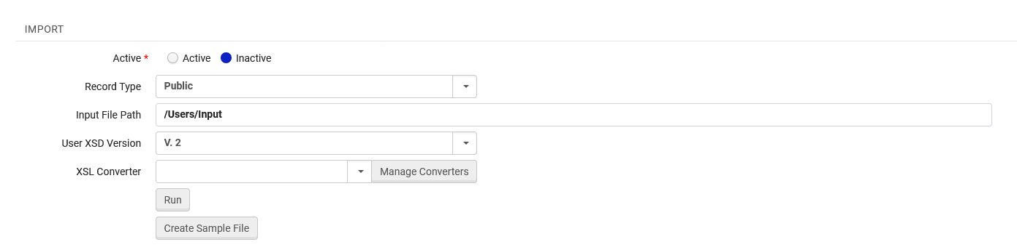
Configuring an Integration Profile of type Users
Fill in the fields for the “Import” section.
Record Type: Each profile loads one type of user (Staff or Public). To process a different user type, another profile is needed.
Input File Path: This is where the file being imported is located. A subdirectory of the path specified when creating the secure FTP connection (required).
User XSD Version: Choose V. 2

Slide 12
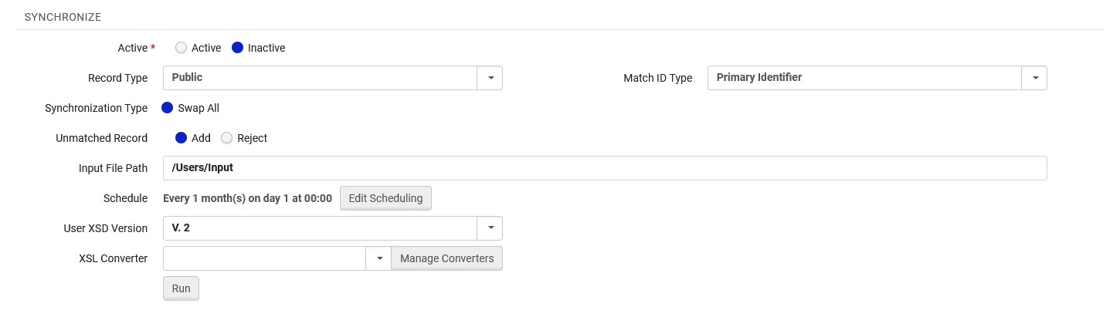
Configuring an Integration Profile of type Users
Fill in the fields for the “Synchronize” section.
Active: If Active then job will run according to schedule. If Inactive it will run when clicking the “Run” button.
Record Type: Each profile loads one type of user (Staff or Public). To process a different user type, another profile is needed.
Match ID Type: The identifier type to use to match existing users.
Synchronization Type: Swap All means that existing user records will be replaced by matching incoming user records.
Unmatched Record: Determines if a record from the input file which does not exist in Alma will be added to Alma or rejected.
Input File Path: This is where the file being imported is located on the FTP server.
User XSD Version: Choose V. 2
Schedule: This is when the job will automatically run if the job is defined as “Active”

Slide 13
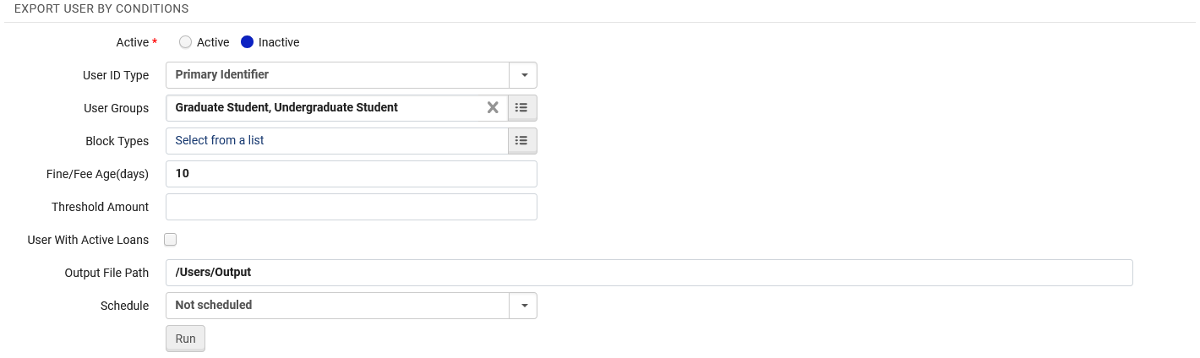
Configuring an Integration Profile of type Users
Fill in the fields for the “Export User By Conditions” section.
Active: If Active then job will run according to schedule. If Inactive it will run when clicking the “Run” button.
User ID Type: The identifier type to use to match existing users.
User Groups: The user group(s) to export. If no value is specified, users with any user group are exported.
Block Types: Users with these block types will be exported. If no value is specified, users with any block type are exported.
Fine/Fee Age (Days): The users (of the selected groups and block types) whose fines/fees are older than the number of days are exported.
Threshold Amount: The users (of the selected groups and block types) whose fines/fees exceed the stipulated threshold are exported.
Users With Active Loans: Export only users that have active loans.
Output File Path: This is where the file being exported will be located on the FTP server.
Schedule: Relevant when the job is defined as “Active”, determines when the job will automatically run.

Slide 14
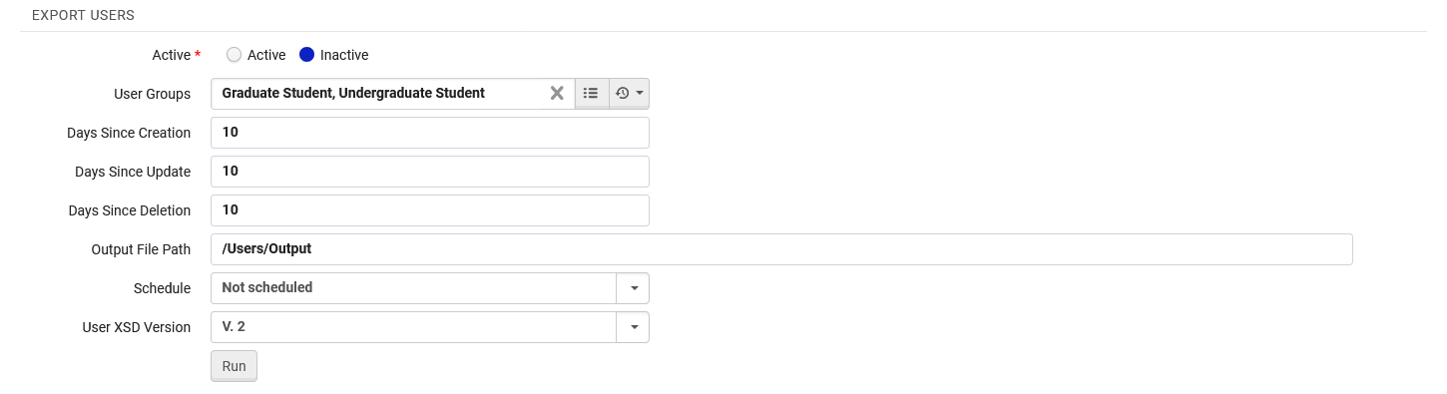
Configuring an Integration Profile of type Users
Fill in the fields for the “Export Users” section.
Active: If Active then job will run according to schedule. If Inactive it will run when clicking the “Run” button.
User Groups: The user group(s) to export. If no value is specified, users with any user group are exported.
Days Since Creation: The number of days since the patron record was created in Alma. For example, if 10 is specified then users created in the past 10 days are included in the export.
Days Since Update: The number of days since the patron record was updated in Alma. For example, if 10 is specified then users updated in the past 10 days are included in the export.
Days Since Deletion: The number of days since the patron record was deleted in Alma. For example, if 10 is specified then users deleted in the past 10 days are included in the export.
Output File Path: This is where the file being exported will be located on the FTP server.
Schedule: Relevant when the job is defined as “Active”, determines when the job will automatically run.
User XSD Version: Choose V. 2

Slide 15
The structure of the input file

Slide 16
The structure of the input file
There are two ways to view the structure of the input file in order for the institution to create their own file with their own users:
View the format at REST API User Format
Create you own sample file from within the Integration Profile based on an existing user
Option two above is advantageous because it gives the institution data based on actual fields and values that the institution uses (as opposed to generic example codes).
For example, it will include the real user group codes and real user identifier type codes (among others) which are used by the institution.

Slide 17
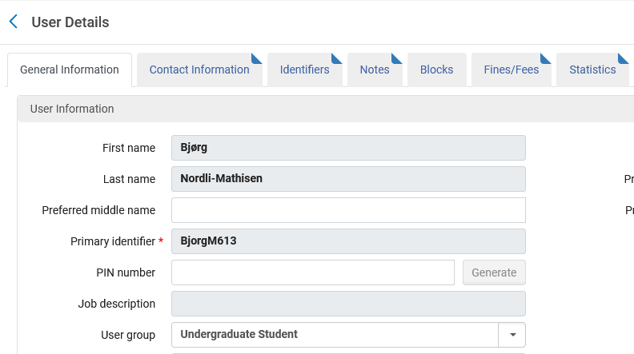
The structure of the input file
For example, we have an existing user in the institution with User Group “Undergraduate Student” and patron role. The Primary Identifier is BjorgM613 and the first and last name is “Bjørg Nordli-Mathisen”
We will create a sample input file based on the data of this user.

Slide 18
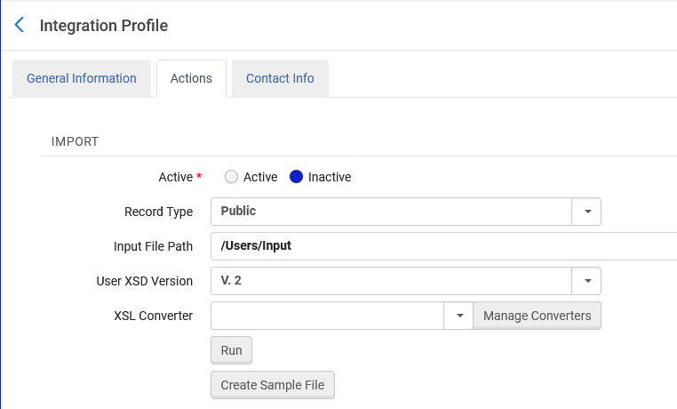
The structure of the input file
From the Integration Profile of type “Users” we will click “Create Sample File” in the “Actions” tab in the “Import” section

Slide 19
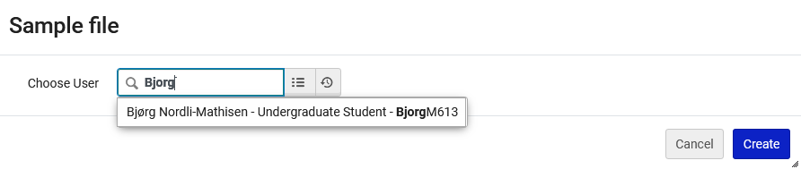
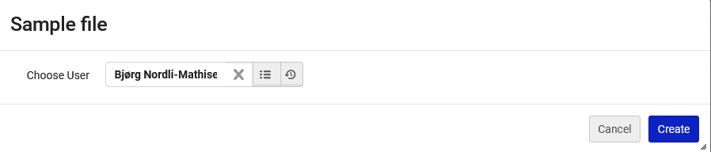
The structure of the input file
We will select the user and click “Create”

Slide 20
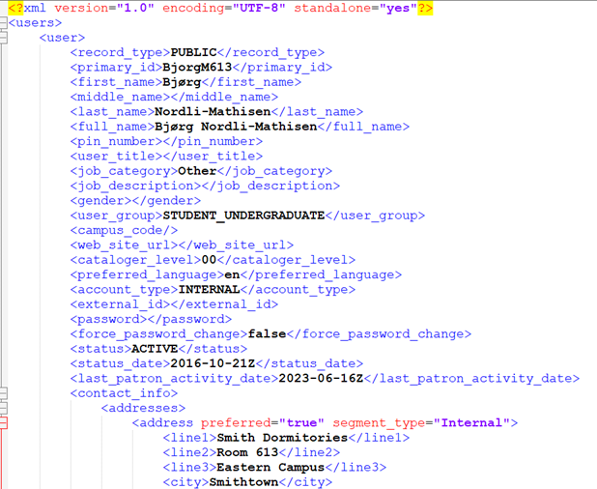
The structure of the input file
A sample file is downloaded with the correct structure for importing (partial screenshot)
This for example is the real User Group code used by the institution.

Slide 21
The structure of the input file
Based on
  The structure of the downloaded sample file
  The structure of the file as explained at REST API User Format (if desired)
The institution can build their own input file.

Slide 22
The sample import file we will be using

Slide 23
The sample import file we will be using
We have an input file which includes two users
Existing user Bjørg Nordli-Mathisen (Primary ID BjorgM613) with an address change (the address in the input file is different than the address in Alma)
New user Daphne Blake (Primary ID DaphneB613).

Slide 24
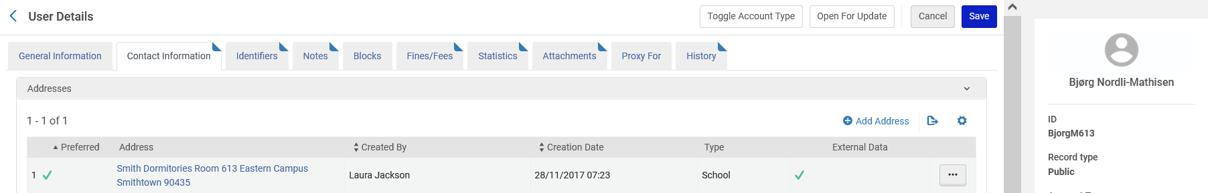
The sample import file we will be using
In Alma existing user Bjørg Nordli-Mathisen (Primary ID BjorgM613) has this address:

Slide 25
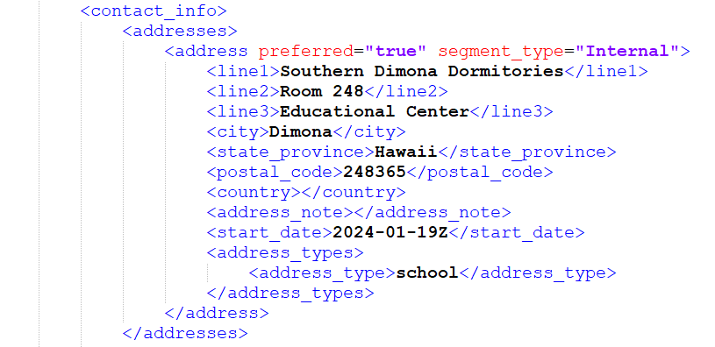
The sample import file we will be using
In the input file existing user Bjørg Nordli-Mathisen (Primary ID BjorgM613) has this address:

Slide 26
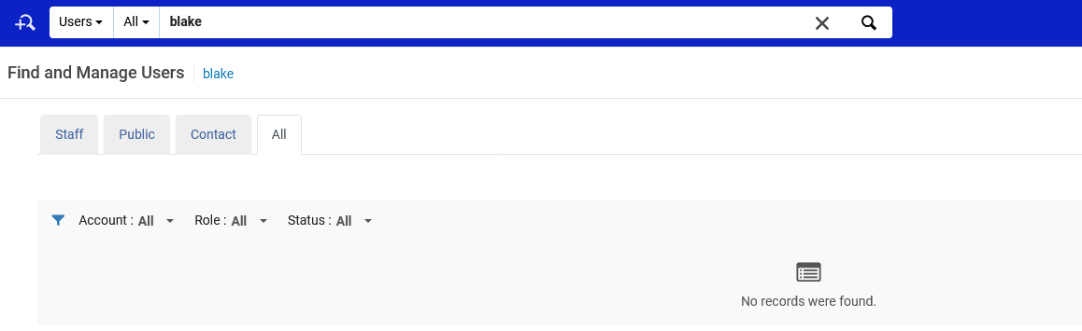
The sample import file we will be using
Currently in Alma there is no user Daphne Blake (Primary ID DaphneB613).

Slide 27
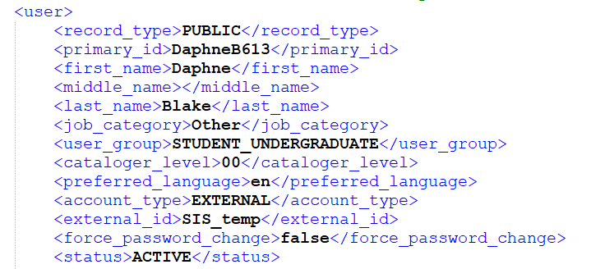
The sample import file we will be using
The input file does contain user Daphne Blake (Primary ID DaphneB613).

Slide 28


The sample import file we will be using
Both records are type “Public”

Slide 29
Importing new users and updating existing users via synchronize

Slide 30
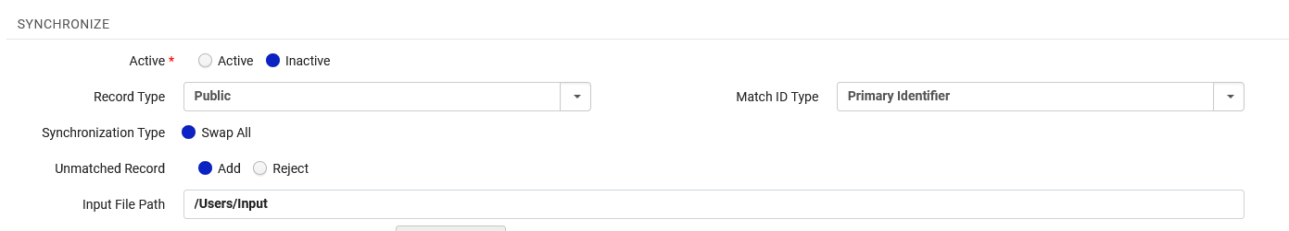
Importing new users and updating existing users via synchronize
The Synchronize” section below in the Integration Profile of type “Users” states:
  Match on the Primary Identifier
  Use Record Type “Public”
  When there is a match “Swap All” (replace) the data in Alma with the data in the input file
  When a match is not found from the input file into Alma then add the user to Alma.
  The file will come from the FTP server which is defined in the “General Information” tab of the profile, from path “/Users/Input”

Slide 31
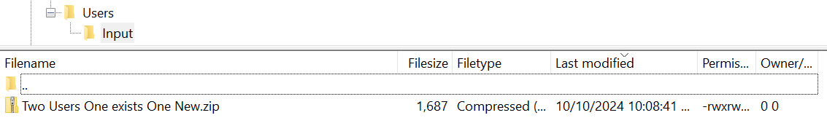
Importing new users and updating existing users via synchronize
The file is on the FTP server which is defined in the “General Information” tab of the profile, in path “/Users/Input”.
The file must be zipped.

Slide 32
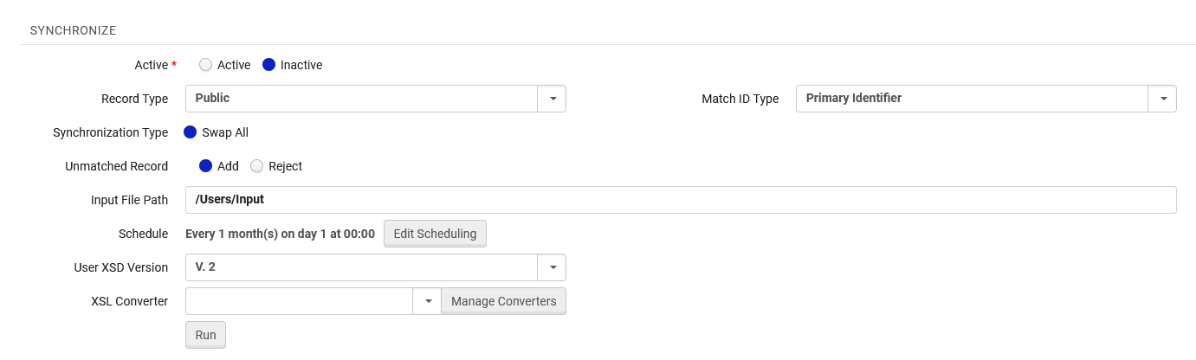
Importing new users and updating existing users via synchronize
We will import the file manually (it could also be scheduled to run automatically)

Slide 33
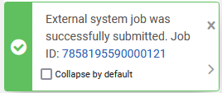
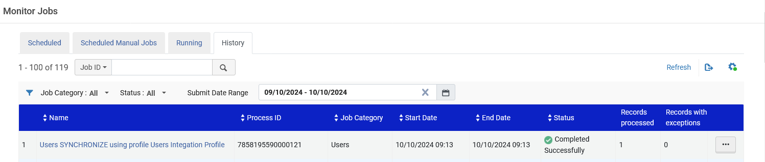
Importing new users and updating existing users via synchronize
The job is submitted and completes

Slide 34
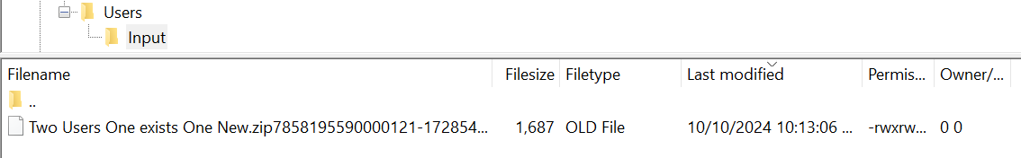
Importing new users and updating existing users via synchronize
The file on the FTP server has been renamed and the “zip” suffix changed to ”OLD” so that the file will not be taken again next time the job runs.

Slide 35
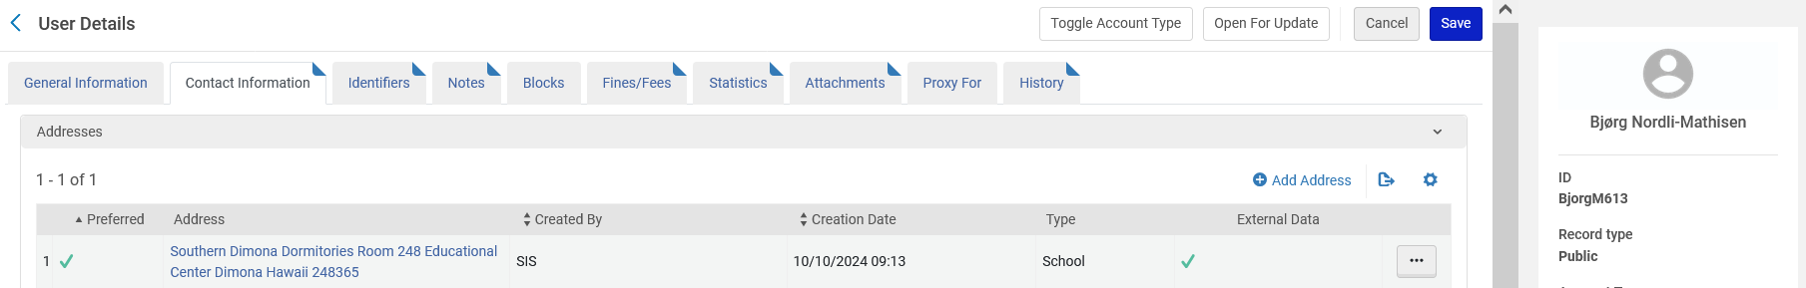
Importing new users and updating existing users via synchronize
Existing user Bjørg Nordli-Mathisen (Primary ID BjorgM613) now has the new (updated) address:
This is the old address:

Slide 36
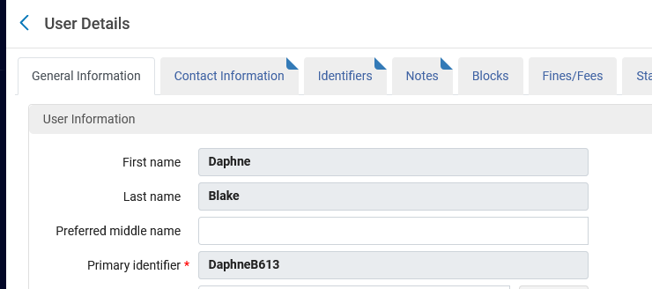
Importing new users and updating existing users via synchronize
New user Daphne Blake (Primary ID DaphneB613) has been created.

Slide 37
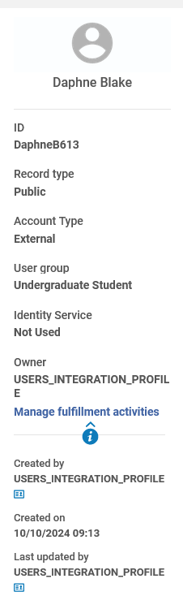
Importing new users and updating existing users via synchronize
We can see that new user Daphne Blake (Primary ID DaphneB613) has been created from the Integration Profile.

Slide 38
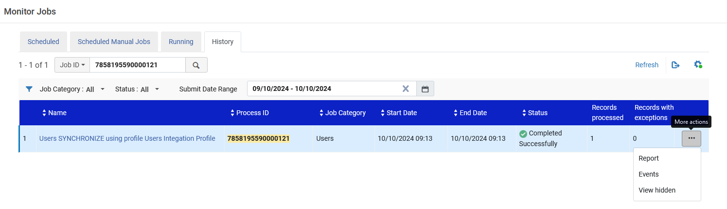
Importing new users and updating existing users via synchronize
We can also see details of what happened via the report of the job.

Slide 39
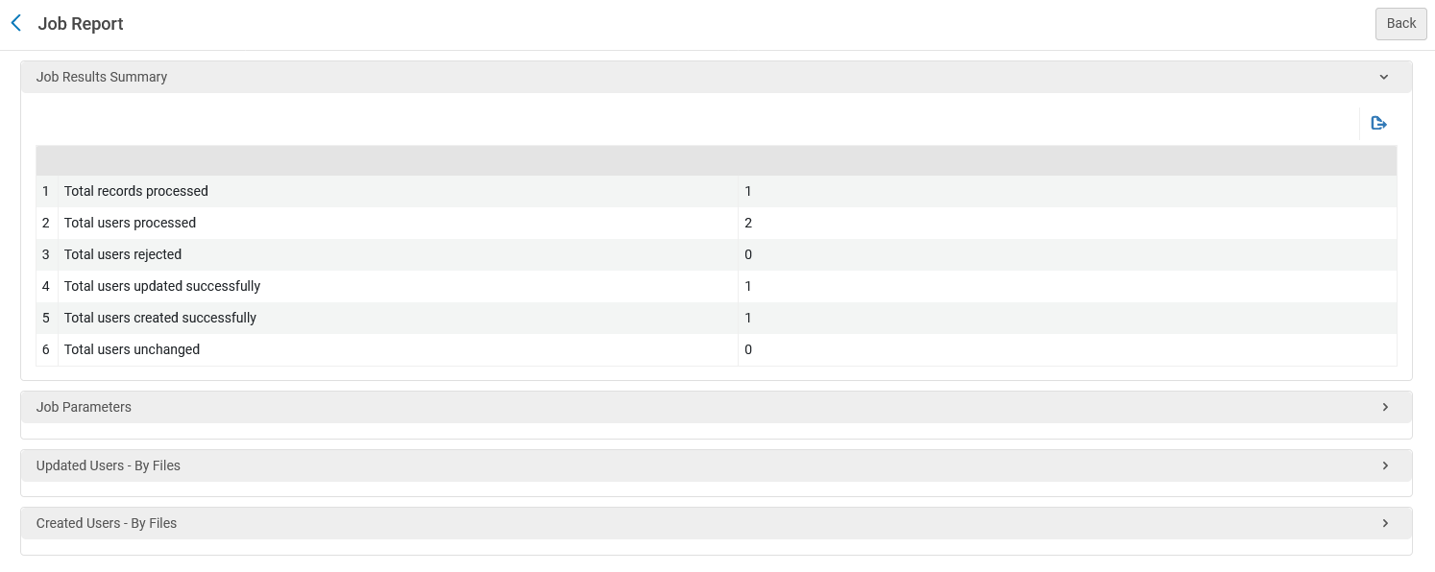
Importing new users and updating existing users via synchronize
One file was processed with two users
One user was updated, and one user was created

Slide 40
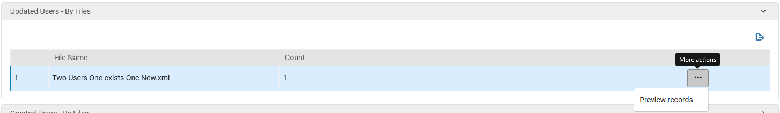
Importing new users and updating existing users via synchronize
We can see which users were updated

Slide 41
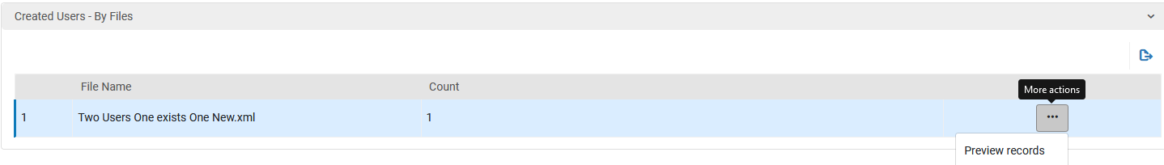
Importing new users and updating existing users via synchronize
We can see which users were created

Slide 42
Exporting user records with blocks or fines via the Integration Profile

Slide 43
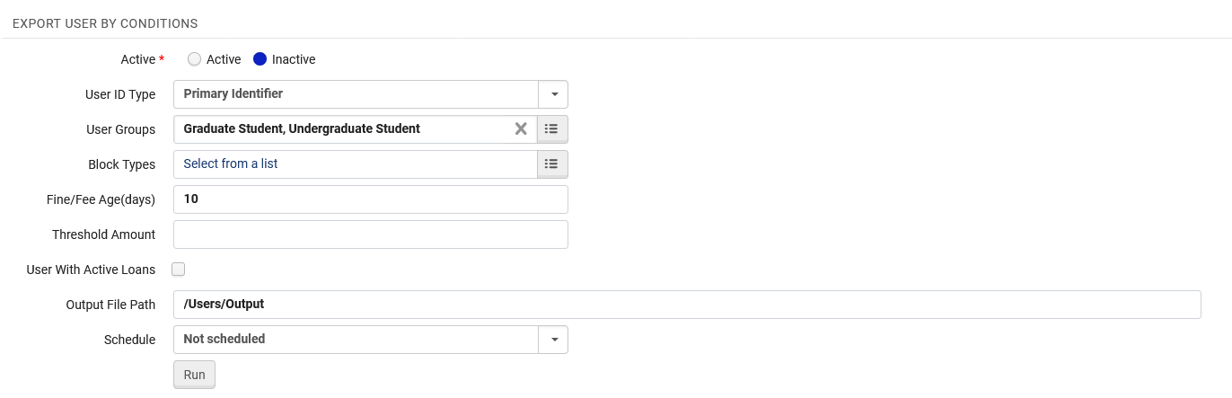
Exporting user records with blocks or fines via the Integration Profile
We will now export users using the “Export user by conditions”
We should now get a file of users who have user group “Graduate” or “Undergraduate” with a fine at least 10 days old or any block and the file will go to the FTP server to folder /Users/Output

Slide 44
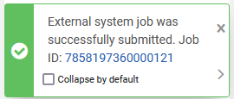
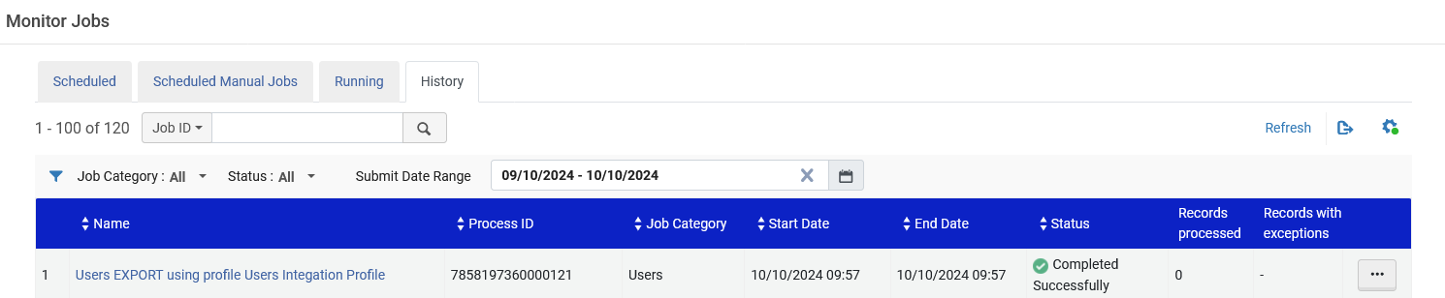
Exporting user records with blocks or fines via the Integration Profile
The job runs and completes

Slide 45
Exporting user records with blocks or fines via the Integration Profile
We can see in the job report that 392 users were exported

Slide 46
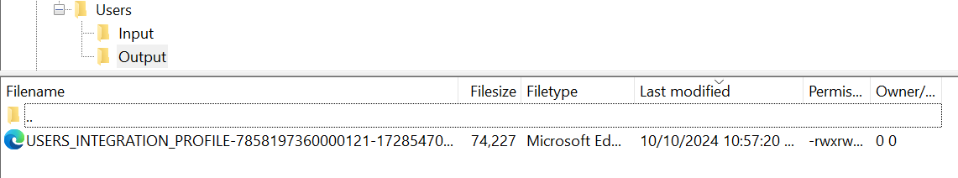
Exporting user records with blocks or fines via the Integration Profile
The file is on the ftp server in the specified directory

Slide 47
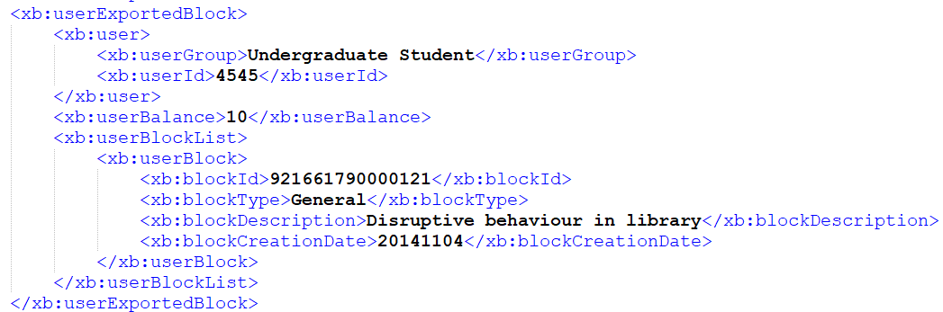
Exporting user records with blocks or fines via the Integration Profile
In the file we see that for example user with primary identifier 4545 is included.
We see here that this user has both a fine and a block

Slide 48
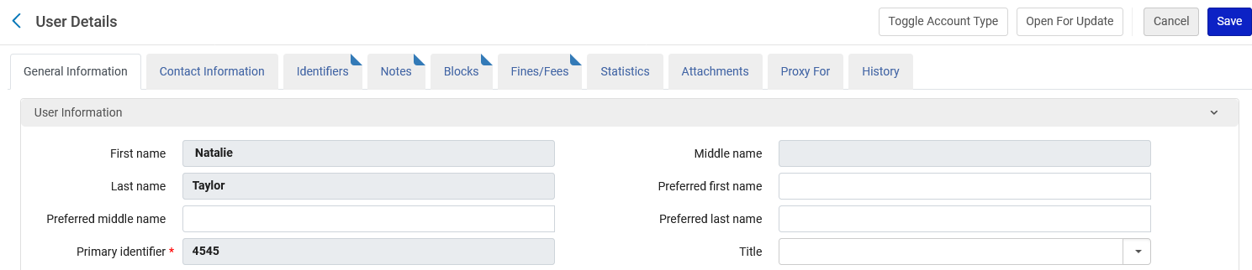
Exporting user records with blocks or fines via the Integration Profile
In Alma we also see that this user has both a fine and a block
Indicators with triangle on top right of the tab that there is a block and a fine

Slide 49
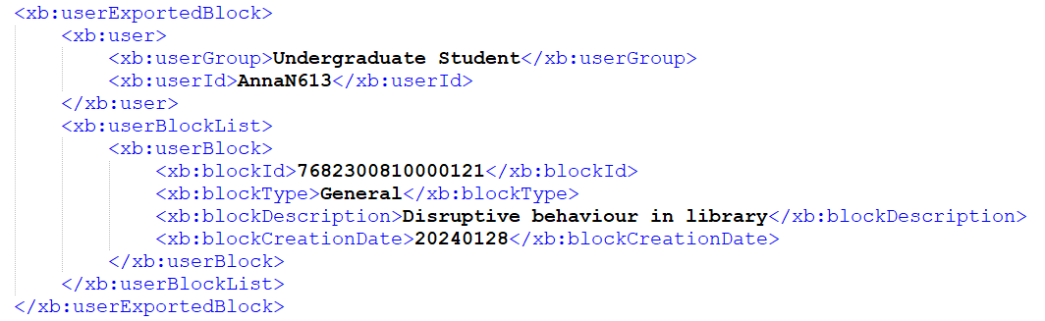
Exporting user records with blocks or fines via the Integration Profile
In the file we see that for example user with primary identifier AnnaN613 is included.
We see here that this user has a block but no fine

Slide 50
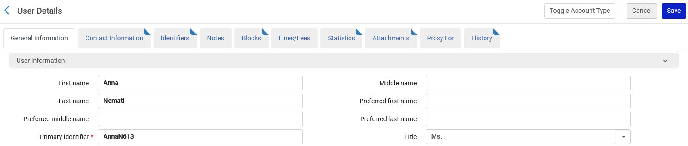
Exporting user records with blocks or fines via the Integration Profile
In Alma we also see that this user has a block but no fine
No fine (no indicator with triangle on top right of the tab that there is a fine)

Slide 51
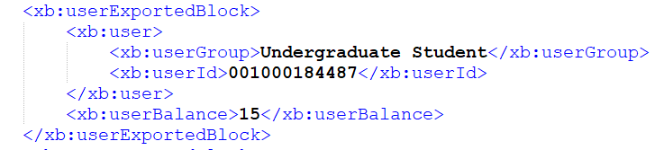
Exporting user records with blocks or fines via the Integration Profile
In the file we see that for example user with primary identifier 001000184487 is included
We see here that this user has a fine but no block

Slide 52
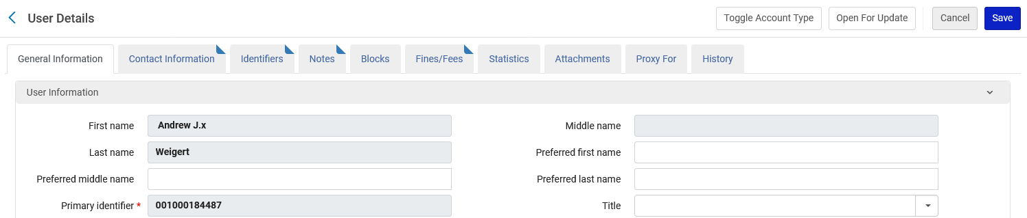
Exporting user records with blocks or fines via the Integration Profile
In Alma we also see that this user has a has a fine but no block
No block (no indicator with triangle on top right of the tab that there is a block)

